Slide 1
Ns-2, the Network Simulator
A discrete event simulator
  Simple model
Focused on modeling network protocols
  Wired, wireless, satellite
  TCP, UDP, multicast, unicast
  Web, telnet, ftp
  Ad hoc routing, sensor networks
  Infrastructure: stats, tracing, error models, etc

Slide 2
ns2- Network Simulator
One of the most popular simulator among networking researchers
  Open source, free
Discrete event, Packet level simulator
  Events like ‘received an ack packet’, ‘enqueued a data packet’
Network protocol stack written in C++
Tcl (Tool Command Language) used for specifying scenarios and events.
  Tcl is used to write the high-level programming, while C++ code is doing the actual simulation for speed consideration
Simulates both wired and wireless networks.

Slide 3
Understand how to write Tcl scripts to simulate simple network topologies and traffic patterns.
Analyze the trace files and understand how to evaluate the performance of networking protocols and operations.

Slide 4
software structure: • uses two languages to separate control and processing: – C++: packet processing; – Otcl: control.
• Packet processing: – C++ makes it fast and detailed;
– C++ makes it scalable.
• Control: – Otcl makes it easy to create scenarios;
– Otcl makes it easy to understand third party scripts

Slide 5
“Ns” Components
Ns, the simulator itself
Nam, the network animator
  Visualize ns (or other) output
  Nam editor: GUI interface to generate ns scripts
    Since we only run ns2 in remote Unix server, we will not introduce Nam usage in this class
  It is not essential to simulation and analysis
Pre-processing:
  Traffic and topology generators (use Tcl to write)
Post-processing:
  Simple trace analysis, often in Awk, Perl, or Tcl
  Can also use grep (under linux), or C/java

Slide 6
Basic Tcl
variables:
set x 10
set z x+10 # string ‘x+10’ to z
set y [expr $x+10]
puts “x is $x”
functions and expressions:
set y [expr pow($x, 2)]
control flow:
if {$x > 0} { return $x } else {
return [expr -$x] }
while { $x > 0 } {
puts $x
incr x –1
}
procedures:
proc pow {x n} {
if {$n == 1} { return $x }
set part [pow x [expr $n-1]]
return [expr $x*$part]
}
Arrays:
set matrix(1,1) 140

Slide 7
Simulations Basic steps:
• Create the simulation environment; – event list, scheduler, etc.;
• Create the network: – nodes and links between them.
• Create connections: – TCP, UDP (in some sense).
• Create applications: – CBR ﬂow, FTP, WWW traﬃc
• Trace network elements: – trace queue, trace ﬂow.

Slide 8
Ns programming
Create the event scheduler
Turn on tracing
Create network
Setup routing
Insert errors
Create transport connection
Create traffic
Transmit application-level data

Slide 9
Creating Event Scheduler
Create event scheduler
  set ns [new Simulator]
Schedule events
  $ns at <time> <event>
    <event>: any legitimate ns/tcl commands
  $ns at 5.0 “finish”
Start scheduler
  $ns run

Slide 10
Simple two node wired network
n0
n1
Step 1:
#Create a simulator object
# (Create event scheduler)
set ns [new Simulator]
Name of
scheduler
Step 2:
#Open trace files
set f [open out.tr w]
$ns trace-all $f

Slide 11
set ns [new Simulator]
set nf [open out.nam w]
$ns namtrace-all $nf
proc finish {} {
global ns nf
$ns flush-trace
close $nf
exec nam out.nam &
exit 0
}
$ns at 5.0 "finish"
$ns run

Slide 12
Simple two node wired network
n0
n1
Step 3:
#Create two nodes
set n0 [$ns node]
set n1 [$ns node]
Step 4:
#Create a duplex link between the nodes
$ns duplex-link $n0 $n1 1Mb 10ms DropTail

Slide 13
Simple two node wired network
#Create a simulator object
set ns [new Simulator]
#Open trace files
set f [open out.tr w]
$ns trace-all $f
#Define a 'finish' procedure
proc finish {} {
global ns f
$ns flush-trace
close $f
exit 0
}
#Create two nodes
set n0 [$ns node]
set n1 [$ns node]
#Create a duplex link between the nodes
$ns duplex-link $n0 $n1 1Mb 10ms DropTail
#Call the finish procedure after 5 seconds of simulation time
$ns at 5.0 "finish"
#Run the simulation
$ns run
But we have no traffic!

Slide 14
Adding traffic to the link
n0
n1
udp
#Create a UDP agent and attach it to node n0
set udp0 [new Agent/UDP]
$ns attach-agent $n0 $udp0

Slide 15
Adding traffic to the link
n0
n1
udp
CBR: constant bit rate
cbr
# Create a CBR traffic source and attach it to udp0
set cbr0 [new Application/Traffic/CBR]
$cbr0 set packetSize_ 500
$cbr0 set interval_ 0.005
$cbr0 attach-agent $udp0

Slide 16
Adding traffic to the link
n0
n1
udp
null
cbr
#Create a Null agent (a traffic sink) and
attach it to node n1
set null0 [new Agent/Null]
$ns attach-agent $n1 $null0

Slide 17
Adding traffic to the link
n0
n1
udp
null
cbr
#Connect the traffic source with the traffic sink
$ns connect $udp0 $null0
#Schedule events for the CBR agent
$ns at 0.5 "$cbr0 start"
$ns at 4.5 "$cbr0 stop”
$ns at 5.0 "finish"
$ns run

Slide 18
Creating Connection and Traffic
UDP
set udp [new Agent/UDP]
set null [new Agent/Null]
$ns attach-agent $n0 $udp
$ns attach-agent $n1 $null
$ns connect $udp $null
CBR
set src [new Application/Traffic/CBR]

Slide 19
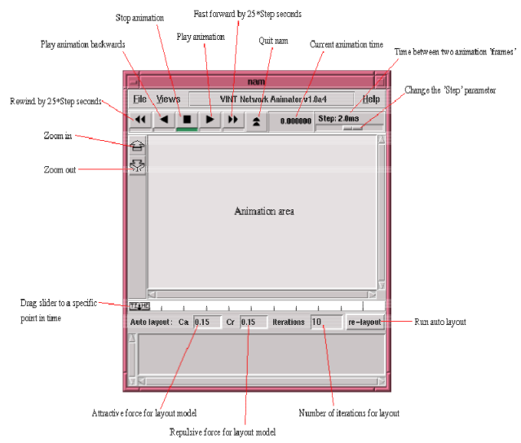

Slide 20
set ns [new Simulator] set nf [open out.nam w] $ns namtrace-all $nf proc finish {} { global ns nf $ns flush-trace close $nf exec nam out.nam & exit 0 } set n0 [$ns node] set n1 [$ns node] $ns duplex-link $n0 $n1 1Mb 10ms DropTail #Create a UDP agent and attach it to node n0 set udp0 [new Agent/UDP] $ns attach-agent $n0 $udp0

Slide 21
#Create a CBR traffic source and attach it to udp0
set cbr0 [new Application/Traffic/CBR]
$cbr0 set packetSize_ 500
$cbr0 set interval_ 0.005
$cbr0 attach-agent $udp0
set null0 [new Agent/Null]
$ns attach-agent $n1 $null0
$ns connect $udp0 $null0
$ns at 0.5 "$cbr0 start"
$ns at 4.5 "$cbr0 stop"
$ns at 5.0 "finish"
$ns run
Try this same example with the different packet size and interval. In the text article we will see how to measure the traffic flowing in the link and plot it on graph.

Slide 22
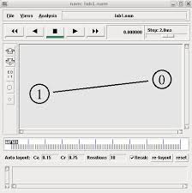

Slide 23
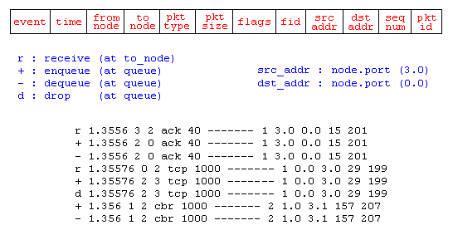
Trace File

Slide 24
Creating Connection and Traffic II
TCP
set tcp [new Agent/TCP]
set tcpsink [new Agent/TCPSink]
$ns attach-agent $n0 $tcp
$ns attach-agent $n1 $tcpsink
$ns connect $tcp $tcpsink
FTP
set ftp [new Application/FTP]
$ftp attach-agent $tcp
Telnet
set telnet [new Application/Telnet]
$telnet attach-agent $tcp

Slide 25
Application-Level Simulation
Features
  Build on top of existing transport protocol
  Transmit user data, e.g., HTTP header
Two different solutions
  TCP: Application/TcpApp
  UDP: Agent/Message

Slide 27
TCP Traffic
#Connect the traffic sources with the traffic sinks
  $ns connect $tcp1 $sink1
  $ns connect $tcp2 $sink2
  $ns connect $tcp3 $sink3
You cannot connect two TCP sources to the same TCP sink
  You can do that for UDP traffic

Slide 28
TCP Traffic
#Create FTP applications and attach them to agents
  set ftp1 [new Application/FTP]
  $ftp1 attach-agent $tcp1
  set ftp2 [new Application/FTP]
  $ftp2 attach-agent $tcp2
  set ftp3 [new Application/FTP]
  $ftp3 attach-agent $tcp3

Slide 29
Simple 2 Nodes Simulation
Simulate a very simple 2-node wireless scenario
The topology consists of two mobilenodes
The mobilenodes move about within 500mX500m area
A TCP connection is setup between the two mobilenodes.
  Packets are exchanged between the nodes as they come within hearing range of one another.
  As they move away, packets start getting dropped.

Slide 30
Define options:
# Define options #
set val(chan) Channel/WirelessChannel ;# channel type
set val(prop) Propagation/TwoRayGround ;# radio-propagation model
set val(ant) Antenna/OmniAntenna ;# Antenna type
set val(ll) LL ;# Link layer type
set val(ifq) Queue/DropTail/PriQueue ;# Interface queue type
set val(ifqlen) 50 ;# max packet in ifq
set val(netif) Phy/WirelessPhy ;# network interface type
set val(mac) Mac/802_11 ;# MAC type
set val(rp) DSDV ;# ad-hoc routing protocol
set val(nn) 2 ;# number of mobilenodes

Slide 31
Define NS simulator
  set ns_ [new Simulator]
Define trace file
  set tracefd [open simple.tr w]
  $ns_ trace-all $tracefd
Create topology object
  set topo [new Topography]
Topography object with (x=500, y=500)
  $topo load_flatgrid 500 500

Slide 32
God (General Operations Director) Object
Create God object:
  create-god $val(nn)
God object stores:
  number of mobilenodes
  table of shortest number of hops required to reach from one node to another
w

Slide 33
Define how a mobile node should be created
$ns_ node-config -adhocRouting $val(rp) \
-llType $val(ll) \
-macType $val(mac) \
-ifqType $val(ifq) \
-ifqLen $val(ifqlen) \
-antType $val(ant) \
-propType $val(prop) \
-phyType $val(netif) \
-topoInstance $topo \
-channelType $val(chan) \
-agentTrace ON \
-routerTrace ON \
-macTrace OFF \
-movementTrace OFF

Slide 34
Manual Create Node Motion
Create two nodes
for {set i 0} {$i < $val(nn) } {incr i} {
set node_($i) [$ns_ node ]
$node_($i) random-motion 0 ;# disable random motion
}
Provide node position and movement(speed & direction)
# Provide initial (X,Y, for now Z=0) co-ordinates
$node_(0) set X_ 5.0
$node_(0) set Y_ 2.0
$node_(0) set Z_ 0.0
$node_(1) set X_ 390.0
$node_(1) set Y_ 385.0
$node_(1) set Z_ 0.0

Slide 35
Produce some node movements
# Node_(1) starts to move towards node_(0)
$ns_ at 50.0 "$node_(1) setdest 25.0 20.0 15.0"
$ns_ at 10.0 "$node_(0) setdest 20.0 18.0 1.0"
# Node_(1) then starts to move away from node_(0)
$ns_ at 100.0 "$node_(1) setdest 490.0 480.0 15.0“
$ns_ at 50.0 "$node_(1) setdest 25.0 20.0 15.0" means at time 50.0s, node1 starts to move towards the destination (x=25,y=20) at a speed of 15m/s.

Slide 36
Setup traffic flow between the two nodes:
# TCP connections between node_(0) and node_(1)
set tcp [new Agent/TCP]
set sink [new Agent/TCPSink]
$ns_ attach-agent $node_(0) $tcp
$ns_ attach-agent $node_(1) $sink
$ns_ connect $tcp $sink
set ftp [new Application/FTP]
$ftp attach-agent $tcp
$ns_ at 10.0 "$ftp start"
a

Slide 37
# Tell nodes when the simulation ends
for {set i 0} {$i < $val(nn) } {incr i} {
$ns_ at 150.0 "$node_($i) reset";
}
$ns_ at 150.0001 "stop"
$ns_ at 150.0002 "puts \"NS EXITING...\“ ; $ns_ halt"
proc stop {} {
global ns_ tracefd
close $tracefd
}
puts "Starting Simulation..."
$ns_ run

Slide 38
Wireless Trace File Analysis
ACTION: [s|r|D]: s -- sent, r -- received, D -- dropped
WHEN: the time when the action happened
WHERE: the node where the action happened
LAYER: AGT -- application,
RTR -- routing,
LL -- link layer (ARP is done here)
IFQ -- outgoing packet queue (between link and mac layer)
MAC -- mac,
PHY -- physical
flags:
SEQNO: the sequence number of the packet

Slide 39
TYPE: the packet type
cbr -- CBR data stream packet
DSR -- DSR routing packet (control packet generated by routing)
RTS -- RTS packet generated by MAC 802.11
ARP -- link layer ARP packet
SIZE: the size of packet at current layer, when packet goes down, size increases, goes up size decreases
[a b c d]: a -- the packet duration in mac layer header
b -- the mac address of destination
c -- the mac address of source
d -- the mac type of the packet body
flags:
[......]: [ source node ip : port_number
destination node ip (-1 means broadcast) : port_number
ip header ttl
ip of next hop (0 means node 0 or broadcast)
]

Slide 40
Example of Trace Intepretation
s 76.000000000 _98_ AGT --- 1812 cbr 32 [0 0 0 0] ------- [98:0 0:0 32 0]
Application 0 (port number) on node 98 sent a CBR packet whose ID is 1812 and size is 32 bytes, at time 76.0 second, to application 0 on node 0 with TTL is 32 hops. The next hop is not decided yet.
r 0.010176954 _9_ RTR --- 1 gpsr 29 [0 ffffffff 8 800] ------- [8:255 -1:255 32 0]
The routing agent on node 9 received a GPSR broadcast (mac address 0xff, and ip address is -1, either of them means broadcast) routing packet whose ID is 1 and size is 29 bytes, at time 0.010176954 second, from node 8 (both mac and ip addresses are 8), port 255 (routing agent).

Slide 41
Trace beginning:
s 0.029290548 _1_ RTR --- 0 message 32 [0 0 0 0] ------- [1:255 -1:255 32 0]
s 1.119926192 _0_ RTR --- 1 message 32 [0 0 0 0] ------- [0:255 -1:255 32 0]
M 10.00000 0 (5.00, 2.00, 0.00), (20.00, 18.00), 1.00
s 10.000000000 _0_ AGT --- 2 tcp 40 [0 0 0 0] ------- [0:0 1:0 32 0] [0 0] 0 0
r 10.000000000 _0_ RTR --- 2 tcp 40 [0 0 0 0] ------- [0:0 1:0 32 0] [0 0] 0 0
s 12.941172739 _1_ RTR --- 3 message 32 [0 0 0 0] ------- [1:255 -1:255 32 0]
s 13.000000000 _0_ AGT --- 4 tcp 40 [0 0 0 0] ------- [0:0 1:0 32 0] [0 0] 0 0
r 13.000000000 _0_ RTR --- 4 tcp 40 [0 0 0 0] ------- [0:0 1:0 32 0] [0 0] 0 0
s 13.242656084 _0_ RTR --- 5 message 32 [0 0 0 0] ------- [0:255 -1:255 32 0]
s 19.000000000 _0_ AGT --- 6 tcp 40 [0 0 0 0] ------- [0:0 1:0 32 0] [0 0] 0 0
r 19.000000000 _0_ RTR --- 6 tcp 40 [0 0 0 0] ------- [0:0 1:0 32 0] [0 0] 0 0
s 24.799296167 _1_ RTR --- 7 message 32 [0 0 0 0] ------- [1:255 -1:255 32 0]
s 27.719583723 _0_ RTR --- 8 message 32 [0 0 0 0] ------- [0:255 -1:255 32 0]

Slide 42
Using node-movement/traffic-pattern files
Node movements for this example shall be read from a node-movement file called scen-3-test.
scen-3-test defines random node movements for the 3 mobilenodes within a topology of 670mX670m.
Provided by NS2 at:
  /usr/local/ns2/ns-2.34/tcl/mobility/scene/scen-3-test
Traffic pattern file
  Provided by NS2 at:
  /usr/local/ns2/ns-2.34/tcl/mobility/scene/cbr-3-test

Slide 43
set val(chan) Channel/WirelessChannel
set val(prop) Propagation/TwoRayGround
set val(netif) Phy/WirelessPhy
set val(mac) Mac/802_11
set val(ifq) Queue/DropTail/PriQueue
set val(ll) LL
set val(ant) Antenna/OmniAntenna
set val(x) 670 ;# X dimension of the topography
set val(y) 670 ;# Y dimension of the topography
set val(ifqlen) 50 ;# max packet in ifq
set val(seed) 0.0
set val(adhocRouting) DSR
set val(nn) 3 ;# how many nodes are simulated
set val(cp) "../mobility/scene/cbr-3-test"
set val(sc) "../mobility/scene/scen-3-test"
set val(stop) 2000.0 ;# simulation time

Slide 44
“Source” node-movement and connection pattern files
#
# Define node movement model
#
puts "Loading connection pattern..."
source $val(cp)
#
# Define traffic model
#
puts "Loading scenario file..."
source $val(sc)

Slide 45
Creating random traffic-pattern for wireless scenarios
ns cbrgen.tcl [-type cbr|tcp] [-nn nodes] [-seed seed] [-mc connections] [-rate rate]
  Cbrgen.tcl is a traffic generator script to generate TCP or CBR traffic
  1/rate is the average interval time between CBR packets
  Connections is the maximum # of connections
  The start times for the TCP/CBR connections are randomly generated with a maximum value set at 180.0s
Example: ns cbrgen.tcl -type cbr -nn 10 -seed 1.0 -mc 8 -rate 4.0 > cbr-10-test
  create a CBR connection file between 10 nodes, having maximum of 8 connections, with a seed value of 1.0 and a rate of 4.0.

Slide 46
Example: ns cbrgen.tcl -type tcp -nn 25 -seed 0.0 -mc 8 > tcp-25-test
  Create a maximum 8 TCP connections (FTP traffic) between 25 nodes.

Slide 47
Creating node-movements for wireless scenarios
Setdest is the program under ~ns/indep-utils/cmu-scen-gen/setdest
./setdest [-n num_of_nodes] [-p pausetime] [-M maxspeed] [-t simtime] \ [-x maxx] [-y maxy] > [outdir/movement-file]
./setdest -n <nodes> -s <speed type> -m <min speed> -M <max speed> -t <simulation time> -P <pause type> -p <pause time> -x <max X> -y <max Y> > [outdir/movement-file]

Slide 48
Example: ./setdest -n 20 -p 2.0 -M 10.0 -t 200 -x 500 -y 500 > scen-20-test
  an average pause between movement being 2s. Simulation stops after 200s and the topology boundary is defined as 500 X 500.

Slide 49
Line in the file:
  $ns_ at 2.000000000000 "$node_(0) setdest 90.441179033457 44.896095544010 1.373556960010”
    node_(0) at time 2.0s starts to move toward destination (90.44, 44.89) at a speed of 1.37m/s.
  $ns_ at 899.642 "$god_ set-dist 23 46 2”
    shortest path between node 23 and node 46 changed to 2 hops at time 899.642.

Slide 50
ns→nam Interface
Color
Node manipulation
Link manipulation
Topology layout
Protocol state
Misc

Slide 51
nam Interface: Color
Color mapping
  $ns color 40 red
  $ns color 41 blue
  $ns color 42 chocolate
Color ↔ flow id association
  $tcp0 set fid_ 40 ;# red packets
  $tcp1 set fid_ 41 ;# blue packets

Slide 52
nam Interface: Nodes
Color
  $node color red
Shape (can’t be changed after sim starts)
  $node shape box ;# circle, box, hexagon
Marks (concentric “shapes”)
  $ns at 1.0 “$n0 add-mark m0 blue box”
  $ns at 2.0 “$n0 delete-mark m0”
Label (single string)
  $ns at 1.1 “$n0 label \”web cache 0\””

Slide 53
nam Interfaces: Links
Color
  $ns duplex-link-op $n0 $n1 color "green"
Label
  $ns duplex-link-op $n0 $n1 label "abced"
Dynamics (automatically handled)
  $ns rtmodel Deterministic {2.0 0.9 0.1} $n0 $n1
Asymmetric links not allowed

Slide 54
nam Interface: Topo Layout
“Manual” layout: specify everything
  $ns duplex-link-op $n(0) $n(1) orient right
  $ns duplex-link-op $n(1) $n(2) orient right
  $ns duplex-link-op $n(2) $n(3) orient right
  $ns duplex-link-op $n(3) $n(4) orient 60deg
If anything missing → automatic layout

Slide 55
nam Interface: Misc
Annotation
  Add textual explanation to your simulation
  $ns at 3.5 "$ns trace-annotate \“packet drop\"“
Set animation rate
  $ns at 0.0 "$ns set-animation-rate 0.1ms"

Slide 56
Record Simulation Trace
Packet tracing:
  On all links: $ns trace-all [open out.tr w]
  On one specific link: $ns trace-queue $n0 $n1$tr
<Event> <time> <from> <to> <pkt> <size> -- <fid> <src> <dst> <seq> <attr>
  + 1 0 2 cbr 210 ------- 0 0.0 3.1 0 0
  - 1 0 2 cbr 210 ------- 0 0.0 3.1 0 0
  r 1.00234 0 2 cbr 210 ------- 0 0.0 3.1 0 0
  Event “+”: enqueue, “-”: dequeue; “r”: received

Slide 57
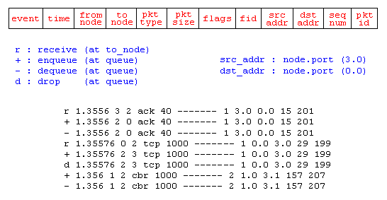
Trace Analysis
http://nsnam.isi.edu/nsnam/index.php/NS-2_Trace_Formats

